Slide 1

Emergent Research in
Environmental Science
GEOLOGICAL SCIENCES
College of Science
University of Texas at El Paso
Geological Science Department
Esenam Ziwu – masters Research Student
Julio Ceniceros – Masters Research Student

Slide 2
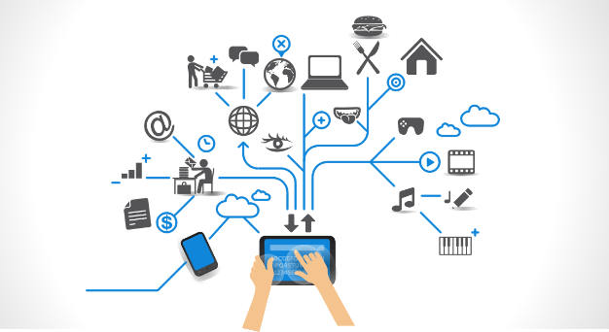
Introduction
We have assessed the current and future state of technology with in our discipline and considered how it relates to our own individual research topics.
  Our approach to assessing the discipline into three sections:
    Data Management & Collection
    Data Integration and Analysis
    WS and WF
    Visualization

Slide 3
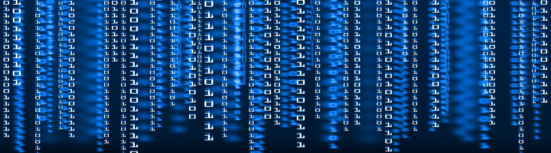
Data Management & Collection
Data Management – A process by which the required data is gathered, validated, stored, protected, and processed. This creates accessibility, reliability, and timeliness for users.
Data Collection - Data collection is the process of gathering and measuring information on targeted variables in an established systematic fashion.

Slide 4
Report #1
Data Source Technical Report
  1) Existing technology
      The Community Research & Development Information Service (CORDIS) which is funded by the European Commission Program (ECP). -jc
  2) Citizen Data
      China and Canada example-ez
  3) Sensor Networks
      TetraScience - jc

Slide 5
Real Example
GitHub – all happy family

Slide 6
Data Integration and Analysis
Data Integration - involves combining data from various sources and providing users with a unified view of these data. This process becomes extremely useful when it crosses various domains and disciplines and can generate new data from the data links.
Analysis of Data - is a process of examining, transforming, and visualizing data with the goal of discovering useful information to support results and decision-making.

Slide 7
Report #2
  1)Maching learning
    IBM Research Lab in South Africa - EZ
  2) Onthologies
    NOAA - Integrated Ocean Observing System (IOOS)-JC
  3) Data mining
    IBM Analytics???? Find example in Env Science-JC

Slide 8
Real example #2
Weka example - ez

Slide 9

Workflows Systems
The Fourth Paradigm defines a work flow as a precise description of a scientific procedure – a multi-step process to coordinate multiple tasks, acting like a sophisticated script.
In other words, someone has created a script to execute multiple computational steps towards any desired output.

Slide 10
Report #3 / Workflow Technical Report
  Heterogeneous Code
    Bio Earth - ez
  Provenance
    The Accelerated Climate Modeling for Energy (ACME) project. -jc
  Benefits of Workflows
    BREATH System - ez

Slide 11
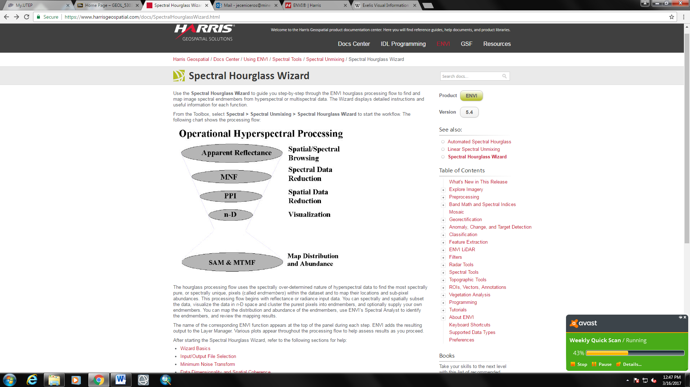
Real Example #3 - jc
ENVI has a tool called the Spectral Hourglass Wizard. This workflow allows the user to find and map image spectral endmembers from hyperspectral or multispectral data. The Wizard displays detailed instructions and useful information for each function.

Slide 12
Visualization
Explanation

Slide 13
Report #4
1
2
3

Slide 14
Real life Example#4

Slide 15
Future

Slide 16
Relevance to our research

Slide 17
Conclusion

Slide 18
Questions?

Slide 19
Citations

